Slide 1
Lecture 13
Ethics and Etiquette in Scientific Research

Slide 2
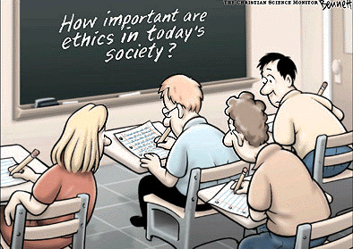
Plan
Authorship, confidentiality, etc. Citation Etiquette
Misappropriation of Ideas
Citing The Source of an Idea
Responsibilities of a Reviewer
Etiquette in the Scientific Community

Slide 3
Ethics
Ethics – the discipline concerned with what is morally good and bad, right and wrong
ethics. ( 2007). In Encyclopædia Britannica. Retrieved October 6, 2007, from Encyclopædia Britannica Online: http://www.britannica.com/eb/article-9106054

Slide 4
Definition of Scientific Misconduct
Scientific misconduct is fabrication, falsification, or plagiarism in proposing, performing, or reviewing research, or in reporting research results.
(Federal Register, October, 1999)

Slide 5
Codes and guidelines evolved because of human subjects’ rights abuses
Nazi experiments using war chemicals, environmental extremes, food and sleep deprivation, etc
Alaskan Eskimos fed radioactive iodine pellets
Tuskegee Alabama study where men with syphilis were “treated” with a placebo instead of a drug

Slide 6
GENERAL BASIC PRINCIPALS OF ETHICS:
1. Honesty : Honestly report data ,results ,methods and procedures and publication status. Do not fabricate, falsify or misinterpret data.
2. Objectivity : Strike to avoid bias in experimental design, data analysis, data interpretation ,peer review etc.
3. честностьIntegrity : Keep your promises and agreements, act with sincerity, strive for consistency of thought and action.
4. Carefulness: Avoid careless errors and negligence . Carefully and critically examine your own work. Keep good record of research activities such as data collection, research design and correspondence with agencies or journals
5. Openness: Share data, results, ideas, tools, resources Be open to criticism and new ideas

Slide 7
1. Why is ethical problems important?
Ethical discussions usually remain detached or marginalized from discussions of research projects. In fact, some researchers consider this aspect of research as an afterthought. Yet, the moral integrity of the researcher is a critically important aspect of ensuring that the research process and a researcher’s findings are trustworthy and valid.

Slide 8
What responsibility do you have toward your research subjects?
The term ethics derives from the Greek word ethos, meaning “character.” To engage with the ethical dimension of your research requires asking yourself several important questions:
• What moral principles guide your research?
How do ethical issues influence your selection of a research problem?
• How do ethical issues affect how you conduct your research—the design of your study, your sampling procedure, and so on?

Slide 9
What responsibility do you have toward your research subjects?
What responsibility do you have toward your research subjects?
What ethical issues/dilemmas might come into play in deciding what research findings you publish?
• Will your research directly benefit those who participated in the study?

Slide 10
A consideration of ethics needs to be a critical part of the substructure of the research process from the inception of your problem to the interpretation and publishing of the research findings.

Slide 11
Codes and Guidelines
1974 – US Congress formed the National Commission for the Protection of Human Subjects in Biomedical and Behavioral Research
1979 – Belmont Report was published as a result of the commissions deliberations
International codes also exist, for example the Code of Nuremberg (1949) and Declaration of Helsinki (1974)
Virtually every journal has a policy statement regarding obtaining informed consent, etc.

Slide 12
Further Developments in the History of Research Ethics
Formal consideration of the rights of research subjects grew out of the revelations of the terrible atrocities that were performed—in the guise of scientific research—on Jews and other racial/ethnic minority groups in Nazi concentration camps during World War II. One result of the revelations of these appalling medical experiments perpetrated on concentration camp prisoners in the name of science resulted in the creation of the Nuremberg Code (1949), a code of ethics that begins with the stipulation that all research participation must be voluntary.

Slide 13
the Declaration of Helsinki (1964),
Other codes of ethics soon followed, including the Declaration of Helsinki (1964), which mandates that all biomedical research projects involving human subjects carefully assess the risks of participation against the benefits, respect the subject’s privacy, and minimize the costs of participation to the subject. The Council for International Organization of Medical Sciences (CIOMS) was also created for those researching in developing nations (Beyrer & Kass, 2002).

Slide 14
Throughout the history of scientific research, ethical issues have captured the attention of scientists and the media alike. Although extreme cases of unethical behavior are the exception and not the rule in the scientific community, an accounting of these projects can provide important lessons for understanding what can happen when the ethical dimension of research is not considered holistically within the research process.

Slide 15
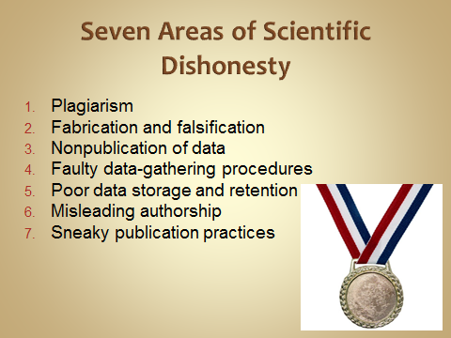

Slide 16

Plagiarism
Plagiarism—using the ideas, writings, and drawings of others as your own
16

Slide 17
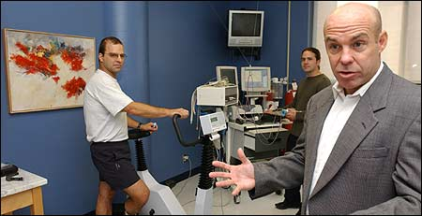
Fabrication and Falsification
Fabrication and falsification—making up or altering data
17

Slide 18
Researcher Faces Prison for Fraud in NIH Grant Applications and Papers
Science 25 March 2005: Vol. 307. no. 5717, p. 1851
A researcher formerly at the University of Vermont College of Medicine has admitted in court documents to falsifying data in 15 federal grant applications and numerous published articles.
Eric Poehlman, an expert on menopause, aging, and metabolism, faces up to 5 years in jail and a $250,000 fine and has been barred for life from receiving any U.S. research funding.
The number and scope of falsifications discovered, along with the stature of the investigator, are quite remarkable. "This is probably one of the biggest misconduct cases ever,"
Poehlman, 49, first came under suspicion in 2000 when Walter DeNino, then a 24-year-old research assistant, found inconsistencies in spreadsheets used in a longitudinal study on aging.
In an effort to portray worsening health in the subjects, DeNino tells Science, "Dr. Poehlman would just switch the data points."

Slide 19
Nonpublication of Data
Sometimes called “cooking data”
Data not included in results because they don’t support the desired outcome
Some data are “bad” data
Bad data should be recognized while it is being collected or analyzed
Outlier – unrepresentative score; a score that lies outside of the normal scores
How should outliers be handled?
19

Slide 20
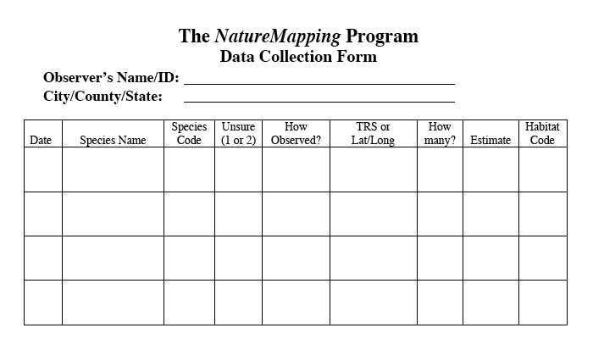
Faulty Data Gathering
Collecting data from participants who are not complying with requirements of the study
Using faulty equipment
Treating participants inappropriately
Recording data incorrectly
20

Slide 21
Data Gathering
Most important and most aggravating.
Always drop non-compliers.
Fix broken equipment.
Treat subjects with respect and dignity.
Record data accurately.
Store data in a safe and private place for 3 years.

Slide 22
Poor Data Storage and Retention
Data should be stored in its original collected form for at least 3 years after publication
Data should be available for examination
Confidentiality of participants should be maintained
22

Slide 23
Misleading Authorship
Misleading authorship—who should be an author?
  Technicians do not necessarily become joint authors.
  Authorship should involve only those who contribute directly.
  Discuss authorship before the project!
23

Slide 24

MSSE Information for Authors
Medicine & Science in Sports & Exercise®
Authorship Requirements
To be an author, each individual shall have contributed to the manuscript in at least two (2) of the following areas:
  Significant manuscript writer
  Significant manuscript reviewer/reviser
  Concept and design
  Data acquisition
  Data analysis and interpretation
  Statistical expertise
Manuscripts with more than six (6) authors require justification for exceeding that number
More info can be found here: http://www.icmje.org/

Slide 25
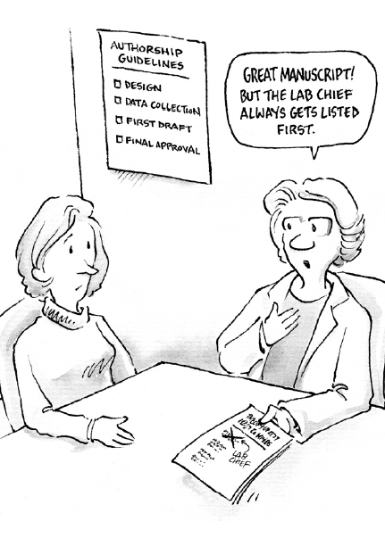
Sneaky Publication Practices
Publication of the thesis or dissertation
  Should be regarded as the student’s work
  Committee chair and members may be listed as secondary authors
Dual publication – a manuscript should only be published in a single journal
  What about studies which include a huge amount of data?
25

Slide 26
Sanctions
Freeze your job.
Reduce your job.
Lose your job.
Loss of institution money and privileges.
Faculty are responsible for students.

Slide 27
The Common Rule mandated, among other things, that any institution receiving federal funds for research must establish an institutional review committee. These committees, known as institutional review boards(IRBs), have the job of watching over all research proposals that involve working with human subjects and animals. Universities and colleges that receive federal funding for research on human subjects are required by federal law to have review boards or for feit their federal funding. IRBs are responsible for carrying out U.S. government regulations proposed for human research.

Slide 28
They must determine whether the benefits of a study outweigh its risks, whether consent procedures have been carefully carried out, and whether any group of individuals has been unfairly treated or left out of the potential positive outcomes of a given study (Beyrer & Kass, 2002). This is, of course, important in a hierarchically structured society where we cannot simply assume racism, sexism, homophobia, and classism are not present in research.

Slide 29
Academic Etiquette
For some reason, academics are not particularly famous for having well-developed social skills, although I don't think we are any more or less socially adept than nonacademics. The shy, awkward professor is a stereotype, although one can, from time to time, see how it might have come about.
Even so, academics can be quite aggressive, especially when it comes to research. Faculty positions and grants are difficult to obtain, we are rewarded for publishing a lot, and our universities seem quite pleased when our work generates public attention (of the positive sort). All of those factors combine to produce a culture that rewards highly assertive faculty members.

Slide 30
For reviewers: When writing a review, even if you think the authors are wrong or have incorrectly and inadequately cited your work, or you don't like their data or their font or their interpretations or the way that they say that your work is flawed, write your criticisms in a constructive and professional way.
20. For researchers: Don't steal ideas. Get your own ideas, or collaborate.

Slide 31
6. For professors: If you don't like another professor, don't take your dislike out on their students and postdocs.
27. For anyone who attends faculty meetings: Don't make faculty meetings last longer than necessary unless you have something really important to say.

Slide 32
The awkwardness and occasional hostility that may arise among scholars in competitive fields gets even more complicated when members of an underrepresented group (such as women in the physical sciences, engineering, and math) are added to the mix. You end up with a rather long list of situations in which people might not behave as well as they could.

Slide 33
Don't make faculty meetings last longer than necessary unless you have something really important to say.

Slide 34
If you see someone you want to talk to at a conference and that person is already in a conversation, try to join in, or ask politely if you can interrupt. Do not simply start talking as if the other person doesn't exist.

